Slide 1
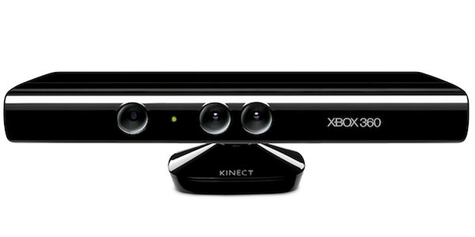
Kinect Workshop
Marco Franssen, Jan Saris
Arnhem, 5 July 2011

Slide 2
What will we do tonight
Introducuction
What is Kinect?
Architecture / Cohesion of projects in the solution
Stuff to think about
Workshop

Slide 3
What is Kinect?
Introducuction
Camera
Can track a users body
Can see depth

Slide 4
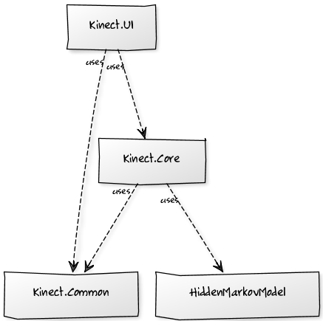
Architecture
Cohesion of the visual studio projects
Demos
Framework
Extensions
Notes:
http://yuml.me/diagram/scruffy;dir:td/class/draw
# Kinect Diagram
[Kinect.Core]uses-.->[HiddenMarkovModel]
[Kinect.Core]uses-.->[Common]
[Kinect.WPF]uses-.->[Common]
[Kinect.WPF]uses-.->[Kinect.Core]

Slide 5
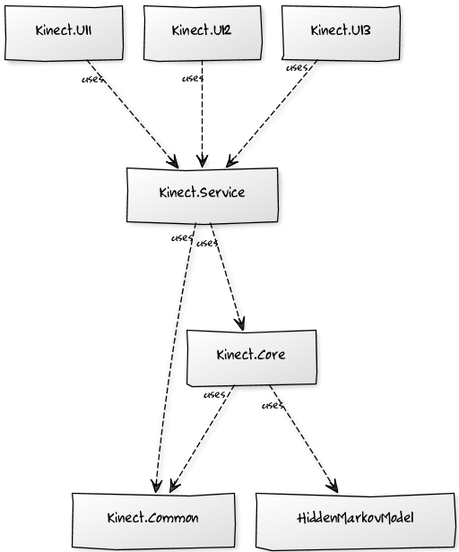
Architecture
Cohesion of the visual studio projects
Demos
Framework
Extensions
Notes:
http://yuml.me/diagram/scruffy;dir:td/class/draw
# Cool UML Diagram
[Kinect.Core]uses-.->[HiddenMarkovModel]
[Kinect.Core]uses-.->[Kinect.Common]
[Kinect.Service]uses-.->[Kinect.Common]
[Kinect.Service]uses-.->[Kinect.Core]
[Kinect.UI3]uses-.->[Kinect.Service]
[Kinect.UI2]uses-.->[Kinect.Service]
[Kinect.UI1]uses-.->[Kinect.Service]

Slide 6
Tips for the workshop
Multi-threading, debugging, performance
Multi-threading
UpdateUserInterface(() => Stuff you want to do);
Debugging your code
Log as much as possible to the Messages
Performance
30 fps
Solution we make in the Gesture Filter part of the workshop
Optional chapter number (Arial 10 regular)

Slide 7
Workshop
Hands-on
Part 0:
Installation
Part 1:
Discover MyKinect
Part 2:
Detect User
Read User data
Part 3:
Create a Filter
Create a Gesture
https://github.com/atosorigin/Kinect

Slide 8
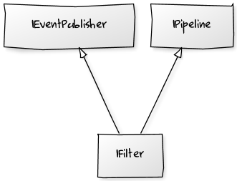

Filters and Gestures
Interfaces
Pipelines
Hidden Markov
Notes:
# Cool UML Diagram
[IPipeline]^-[IFilter]
[IEventPublisher]^-[IFilter]
# Cool UML Diagram
[User : IEventPublisher]->[MyFilter : IFilter]
[MyFilter : IFilter]->[MyGesture : IPipeline]

Slide 9
For more information please contact: Marco Franssen +31 (0)6 83 62 73 00 marco.franssen@atos.net
Jan Saris +31 (0)6 52 54 22 69 jan.saris@atos.net

